Slide 1
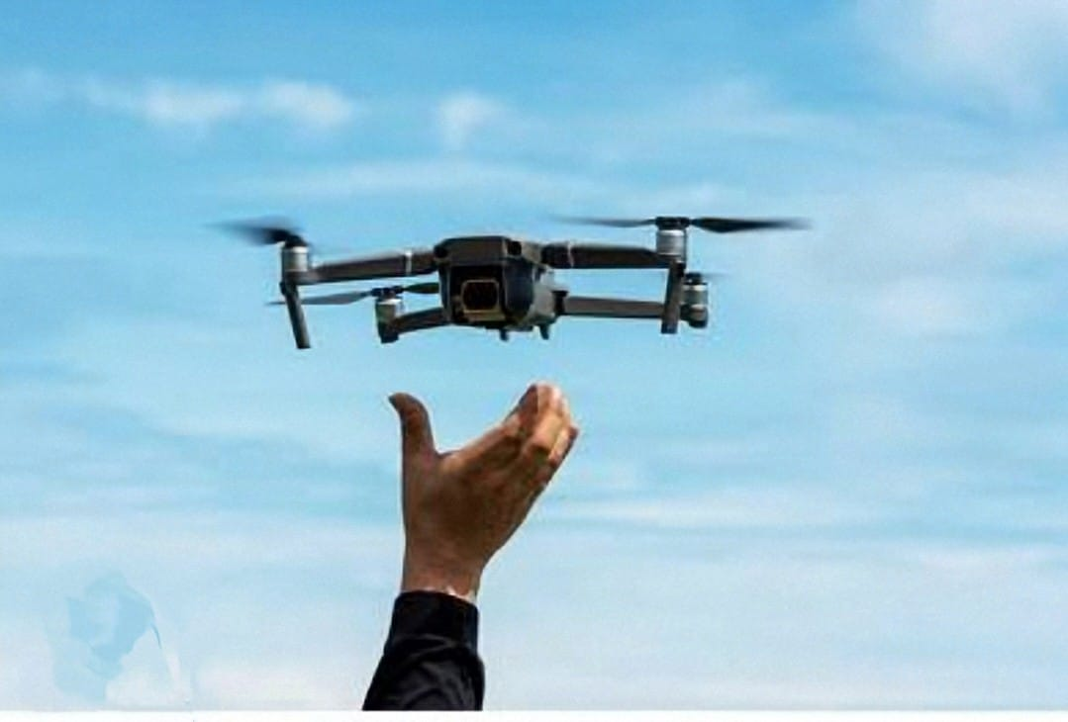
Drone Controlled by hand gesture
By: Monalika Singh
Nidhi Chauhan
Pratibha Mishra
Dept. of Electrical Engineering, NIT Delhi
Supervisor: Dr. Sachin Singh

Slide 2
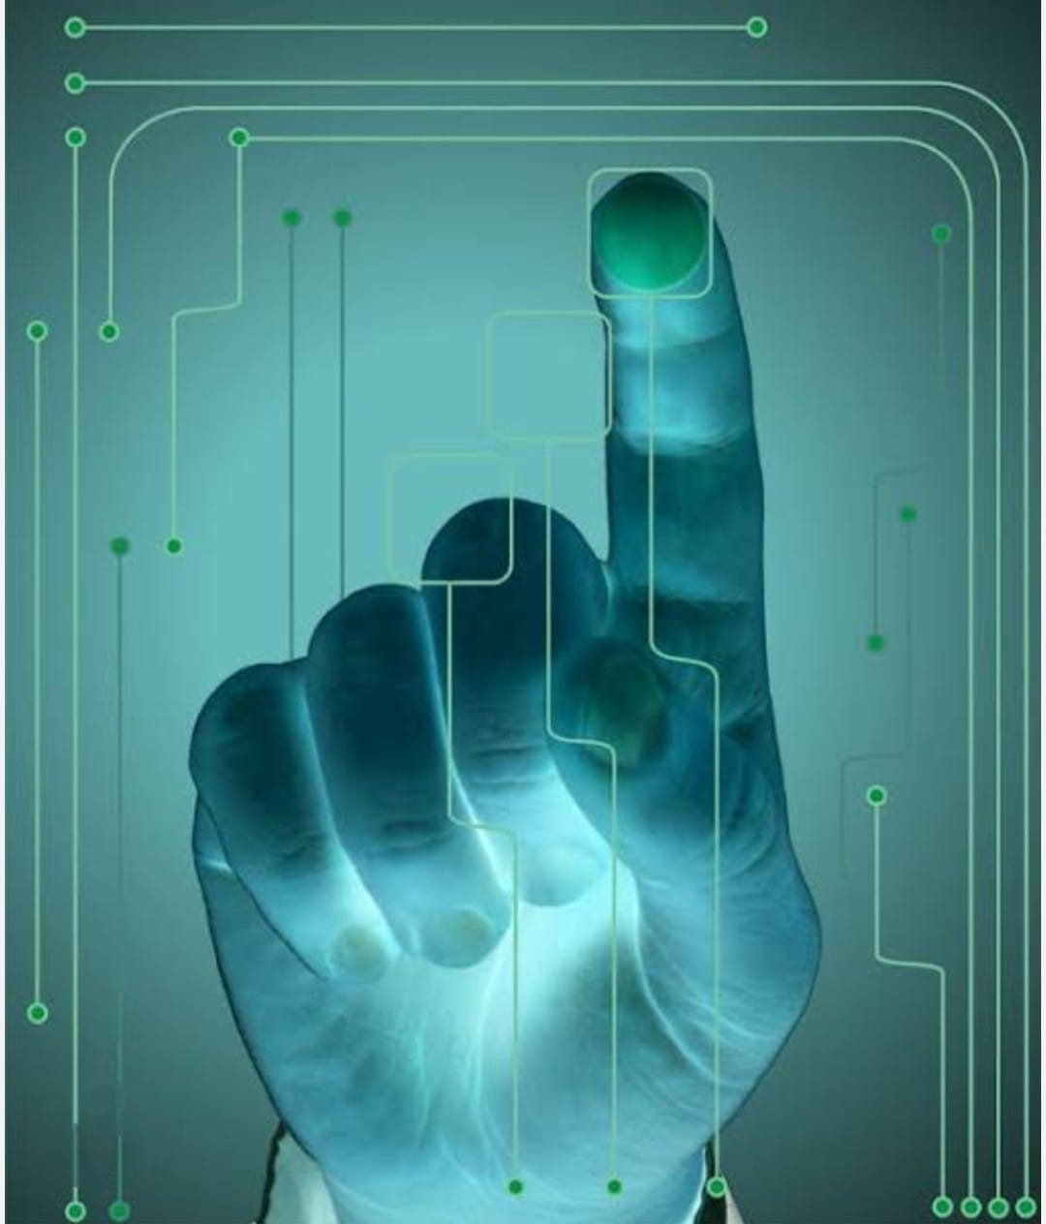
Introduction
Unmanned Aerial Vehicles (UAVs), commonly known as drones, are widely used across industries ranging from photography to surveillance and agriculture. Traditional control methods often rely on joysticks or smartphone interfaces. However, with the growing interest in natural user interfaces, gesture control presents a more intuitive and human-centered way of interacting with drones.
Gesture-controlled drones utilize computer vision and machine learning techniques to interpret human gestures as flight commands. Python, due to its simplicity and rich ecosystem of libraries, is an ideal language for developing such systems. Libraries like OpenCV, and TensorFlow allow real-time hand tracking, gesture classification, and seamless integration with drone control APIs.
In this project, we demonstrate a Python-based system that uses a webcam to capture hand gestures, recognizes predefined gestures using computer vision techniques, and translates these into flight commands for the drone. This enables users to control the drone's movement — such as takeoff, landing, and directional navigation — through simple hand gestures, without any physical remote.

Slide 3
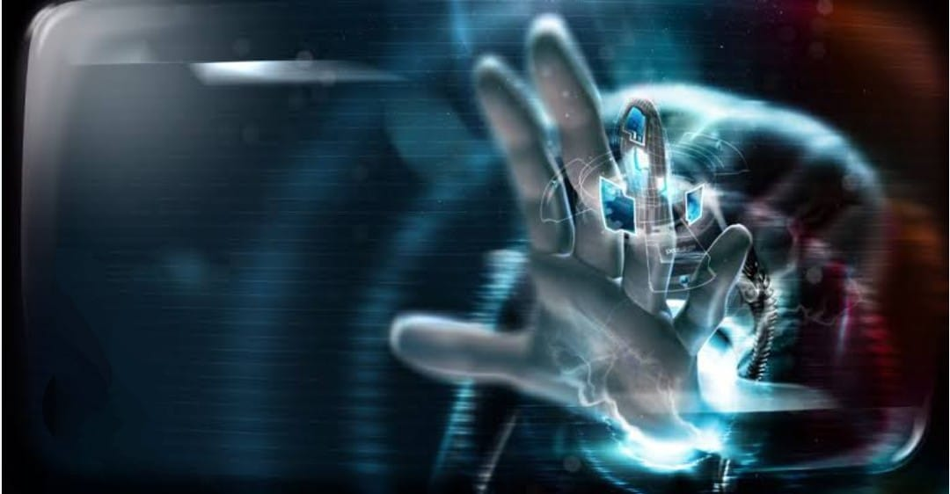
Project Objective
The main goal of this project is to create a system that allows a person to control a drone using just their hand gestures—without needing a remote control or smartphone. By using a regular webcam and Python, the system will recognize hand movements like waving, pointing, or raising a palm, and translate those into commands like takeoff, land, or move in different directions. This makes flying a drone easier, more natural, and more accessible, especially for beginners or in situations where using a remote is not practical.

Slide 4
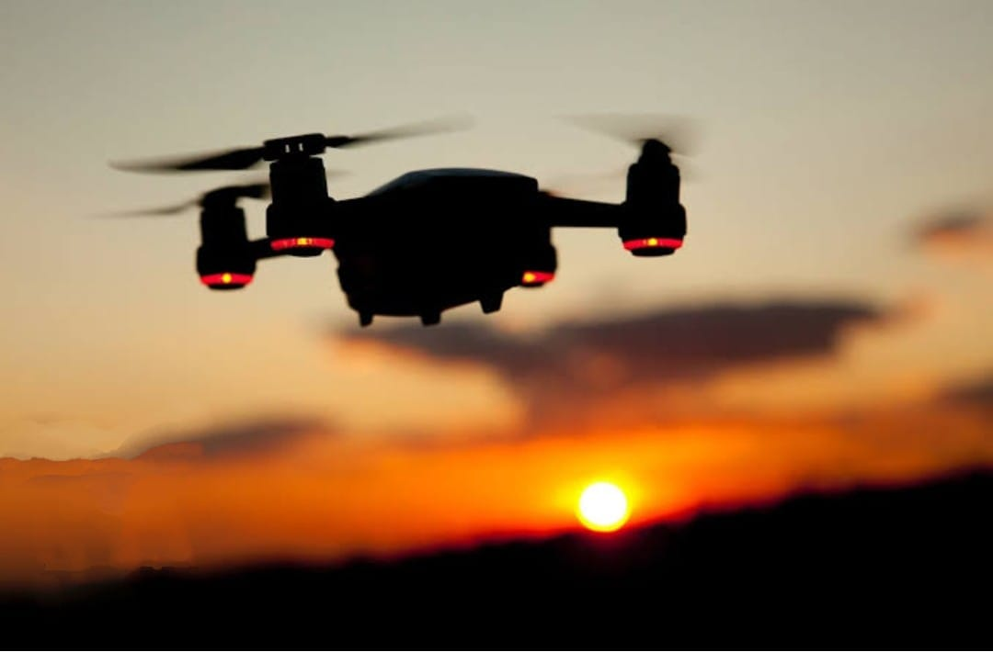
Software & Tools Used
To build a system that lets you control a drone using hand gestures, we follow a step-by-step approach that combines computer vision with drone control. Here's how it works:
Capture Hand Gestures with a Camera We start by using a webcam (built-in or external) to capture live video of the user’s hand movements. This video feed is the input to our system.
Detect the Hand and Track Its Movements Using Python and a library called Utils.py, we detect the hand in the video and identify key points like fingers and palm. This lets the system know exactly how the hand is positioned and moving in real time.
Recognize Specific Gestures We define a few simple gestures, such as:
Open palm for "take off"
Closed fist for "land"
Hand moving forward to move the drone forward These gestures are recognized by analyzing the hand landmarks and their position changes.
Translate Gestures Into Drone Commands Once a gesture is recognized, we map it to a drone command (like takeoff, move forward, etc.).

Slide 5
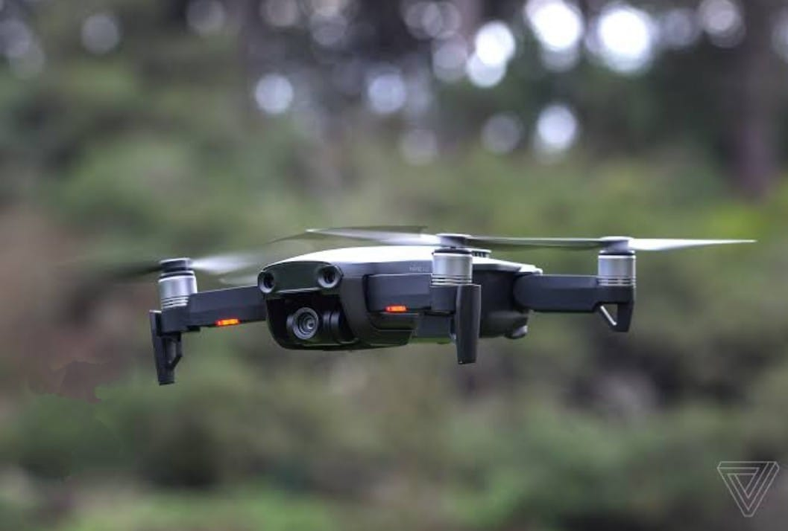
Software code
import cv2
import numpy as np
import pygame
from utils import detect_hand_center
# Initialize Pygame screen
pygame.init()
WIDTH, HEIGHT = 640, 480
screen = pygame.display.set_mode((WIDTH, HEIGHT))pygame.display.set_caption("Drone Gesture Control")
clock = pygame.time.Clock()
# Drone position and properties
drone_x, drone_y = WIDTH // 2, HEIGHT // 2
DRONE_RADIUS = 20

Slide 6
# Pygame part
screen.fill((0, 0, 0))
pygame.draw.circle(screen, DRONE_COLOR, (drone_x, drone_y), DRONE_RADIUS)
pygame.display.update()
# Event handler for quit
for event in pygame.event.get():
if event.type == pygame.QUIT:
running = False
if cv2.waitKey(1) & 0xFF == ord('q'):
running = False
clock.tick(30)
cap.release()
cv2.destroyAllWindows()
pygame.quit()

Slide 7
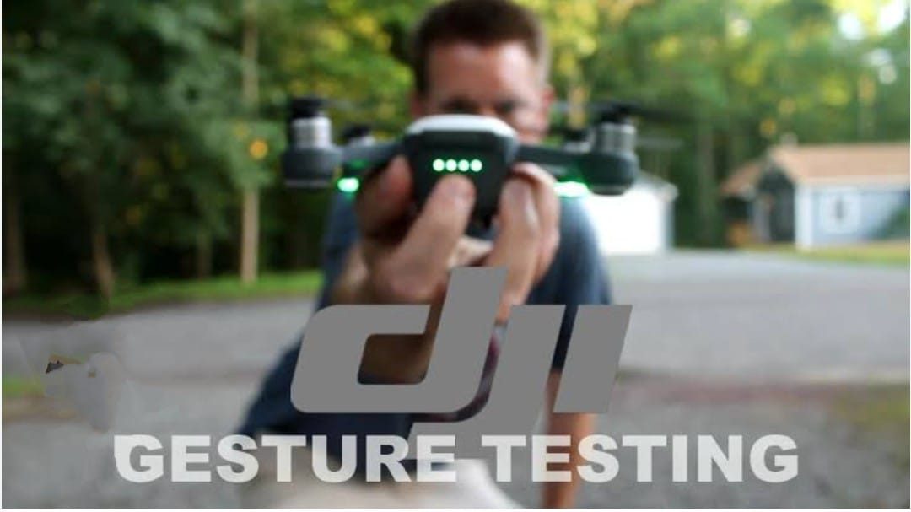
Gesture Mapping
After building and testing the gesture-controlled drone system, we were able to successfully control basic drone movements using hand gestures captured through a webcam.
→ Open Palm: Takeoff
→ Closed Fist: Land
→ Hand Forward: Move Forward
→ Hand Backward: Move Backward
→ Tilt Left/Right: Turn Left/Right
Extensible to more gestures using ML models.
The system sometimes misinterpreted gestures, especially when the hand moved too quickly or was partially out of frame.
Similar-looking gestures (e.g., a slightly open palm vs. fully open) could confuse the system.
Complex or custom gestures were hard to detect reliably without training a dedicated machine learning model.

Slide 8
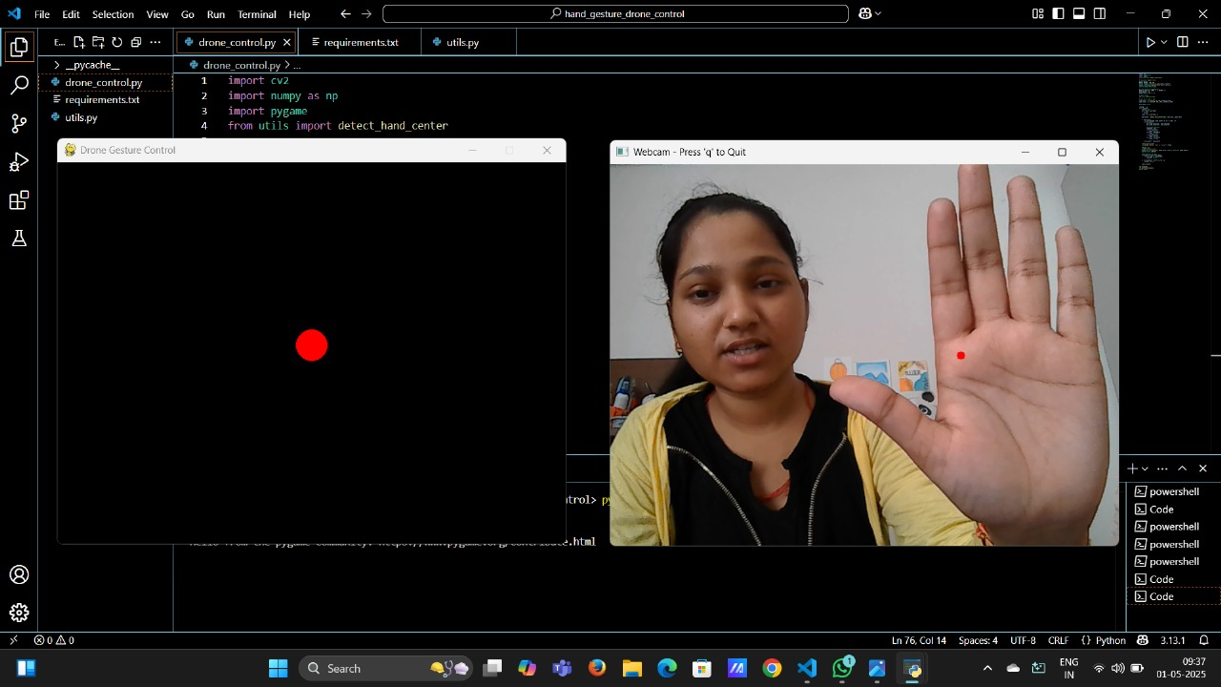

Slide 9
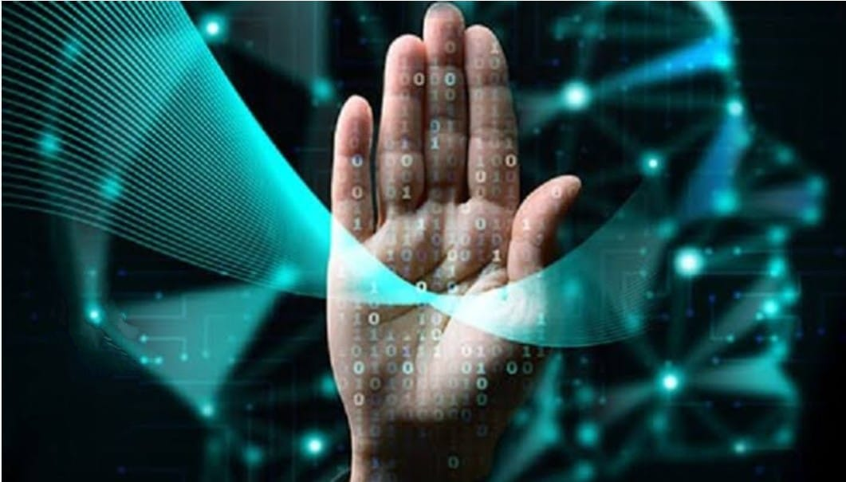
Challenges
While developing the gesture-controlled drone system, we faced several challenges and limitations that affected performance and user experience. These are important to understand for future improvements:
The system sometimes misinterpreted gestures, especially when the hand moved too quickly or was partially out of frame.
Similar-looking gestures (e.g., a slightly open palm vs. fully open) could confuse the system.
Complex or custom gestures were hard to detect reliably without training a dedicated machine learning model.
Good lighting was essential for accurate hand tracking. In dim light or with shadows, the system struggled to detect hand landmarks correctly.
Bright sunlight or reflective surfaces caused glare that interfered with the webcam feed.

Slide 10
Conclusion from testing
The testing of the gesture-controlled drone system demonstrated that it is feasible to control a drone using hand gestures in real-time with Python and computer vision techniques. The system successfully detected and recognized basic hand gestures, such as takeoff, landing, and directional movements, providing an intuitive and hands-free way to control the drone.
While the system performed well under optimal conditions, such as good lighting and clear backgrounds, some challenges were encountered, including occasional misinterpretation of gestures and performance issues in low-light environments. Additionally, the limited gesture set and minor latency were factors that affected the overall user experience.
Despite these challenges, the project shows great potential for applications in areas where traditional remote controls are impractical, such as in search-and-rescue missions, drone filming, or hands-free control for people with disabilities.
With further refinement in areas like gesture recognition accuracy, lighting adaptability, and expanded gesture options, this technology could evolve into a powerful tool for more advanced drone operations in the future.

Slide 11
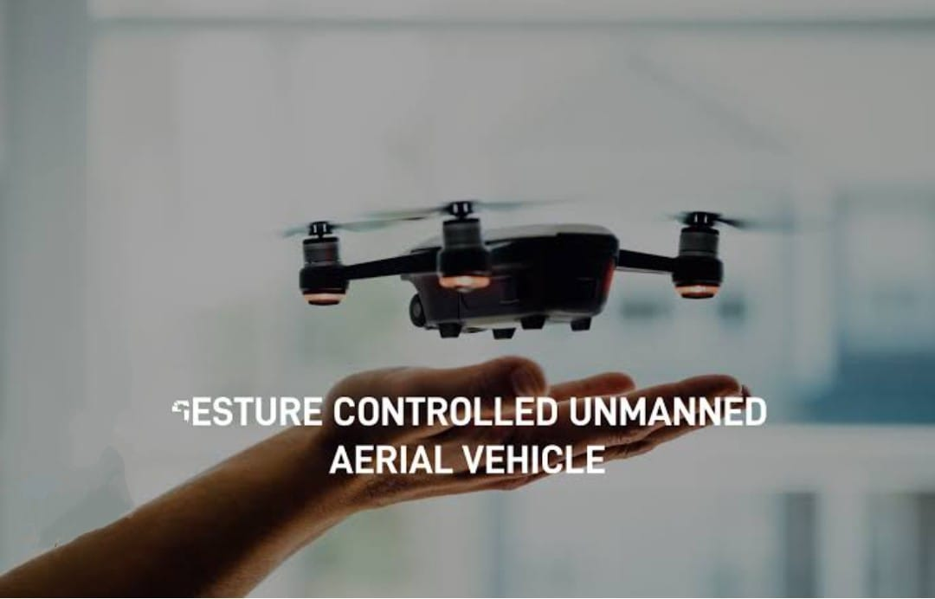
Summary of Key result
Gesture Detection: The system successfully detected and tracked hand gestures in real-time using a webcam and MediaPipe. Basic gestures, such as "open palm" for takeoff and "closed fist" for landing, were recognized with good accuracy.
Drone Control: The drone responded to recognized gestures by performing actions like takeoff, landing, and moving in different directions (forward, backward, left, and right) based on hand movements.
Performance: The system showed low latency (around 0.5–1 second) in translating hand gestures into drone actions, with real-time feedback and control in most scenarios.
Lighting Sensitivity: The system performed best under optimal lighting conditions but struggled in low light or cluttered backgrounds, impacting gesture recognition accuracy.
Limitations: Gesture accuracy decreased with fast hand movements, and the system supported only a limited set of gestures. The drone’s performance was also constrained by battery life and range.

Slide 12
THANK YOU !!!
BY :
NIDHI CHAUHAN (231230038)
MONALIKA SINGH (231230036)
PRATIBHA MISHRA (231230041)

